Slide 1
Event Driven Architecture
An Introduction…

Slide 2
The Great Debate…
http://martinfowler.com/articles/dont-start-monolith.html
Monolith First?
Micro services First?
http://martinfowler.com/bliki/MonolithFirst.html

Slide 3
Monolithic
Orders
Invoicing
Inventory
Logging
Warehouse
Profiles
Notes:
This is how a monolith is built

Slide 4
A problem with ‘Monolith First’
A product of our agile approach to our projects are more smaller features finished earlier.
The goal is to deploy more often…this is hard.
One solution is to have smaller applications.
Notes:
While our features are smaller, the testing effort hasn’t changed.
We can rely some on test automation, but even these test suites can get inflated.

Slide 5
Why?
No point-to-point integrations
Loosely coupled, highly scalable systems
Easier to test
Easier to change

Slide 6
SOA
Orders
Invoicing
Inventory
Logging
Profiles
Warehouse
Tightly Coupled
Notes:
How do you do system-wide logging?
Mention ESB bus (expensive, requires specialized skillsets, did I say expensive).

Slide 7
Event Driven Development
An Event is represents something that happens in a domain
Customer Submits Order
Customer Billed
Payment Received
Order Ready for Shipment
Order Shipped
While Events and their payload are designed at the enterprise system level, their implementations are left to the specific subsystems.

Slide 8

Loosely Coupled
Orders
Invoicing
Inventory
Event Bus
Logging
Profiles
Reporting

Slide 9
Easy to Modify
Orders
Invoicing
Inventory
Event Bus
Logging
Profiles
Reporting
New System
Notes:
Add a new subsystem and start consuming events that are already in the system

Slide 10
Scales
Inventory
Inventory
Orders
Invoicing
Inventory
Inventory
Event Bus
Logging
Profiles
Reporting

Slide 11
The basic thesis of this article is that organizations which design systems (in the broad sense used here) are constrained to produce designs which are copies of the communication structures of these organizations.
--- Melvin Conway
Notes:
Do our software systems do not create friction in the organization

Slide 12
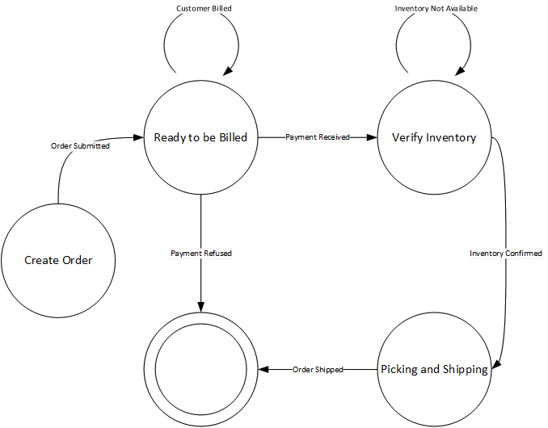
Easily Modeled as a finite state diagram

Slide 13
Other benefits
Ease of 3rd party integration
Can be deliberate about scaling
Fault tolerant
Event messages can be logged and ‘replayed’
Can test subsystems in isolation

Slide 14
A Retail System
Sales
Logger
Rabbit MQ Exchange
Invoicing
Shipping
Warehouse
Notes:
Add a new subsystem and start consuming events that are already in the system

Slide 15
Order Accepted Event is generated
Sales
Logger
Rabbit MQ Exchange
Invoicing
Shipping
Warehouse
Notes:
Add a new subsystem and start consuming events that are already in the system

Slide 16
Customer Billed Event
Sales
Logger
Rabbit MQ Exchange
Invoicing
Shipping
Warehouse
Notes:
Add a new subsystem and start consuming events that are already in the system

Slide 17
Order Ready for Shipment Event
Sales
Logger
Rabbit MQ Exchange
Invoicing
Shipping
Warehouse
Notes:
Add a new subsystem and start consuming events that are already in the system

Slide 18
Order Shipped
Sales
Logger
Rabbit MQ Exchange
Invoicing
Shipping
Warehouse
Notes:
Add a new subsystem and start consuming events that are already in the system

Slide 19
Logger Consumes EVERY Event
Sales
Logger
Rabbit MQ Exchange
Invoicing
Shipping
Warehouse
Notes:
Can replay any chain of events for debugging purposes (and quality checks of production)

Slide 20
Event-driven architecture is a versatile approach to designing complex software systems. These systems tend to be easier to model for an organization as EDA embraces Conway’s Law and can often be modeled as a finite state machine. Event-driven architecture is not a new concept, but as more organizations embrace micro services, this approach to system design has become appropriate in more situations. In this talk we’ll: introduce event-driven architecture, talk about key components, look at a sample implementation of a retail system.

